Slide 1
Intro to Dr. Shantanu Pathak
PhD CSE (Machine Learning), ME-IT, BE-IT
Worked with IT leaders like
Tech-Mahindra, Amdocs, Honeywell, Sibros,CAT (Caterpillar), Varroc, Envestnet, etc
Total 20+ years of experience as a Developer + Trainer
Holds 1 patent
Author (3 books + more than 10 publications)
shantanu.s.pathak@gmail.com
Linked in : https://www.linkedin.com/in/pathakshantanu/

Slide 2
Machine Learning
By Dr Shantanu Pathak

Slide 3
Machine Learning
"Field of study that gives computers the ability to learn without being explicitly programmed" defined by Prof. Arthur Samuel in 1959
Software learns the patterns in Data
Classical Programming::
I/P :: Rules and Sample Data
O/P :: Answers
Machine Learning
I/P :: Huge Data and Answers
O/P :: Patterns / Rules

Slide 4
Introduction
Machine Learning :
machines find the pattern in input data.
This pattern is mapped to certain output.
Then using this pattern and mapping machine can predict the output for new inputs
This pattern and mapping is knowledge!
Example :
Machine finds patterns in images of dogs and cats.
Also it maps patterns with output that whether it is dog or cat
Another example :
If diabetic patient data is available
Then machine will find pattern in age, BP , sugar level
Then map this pattern to class (diabetic / non-diabetic)

Slide 5
Why Machine Learning?
Deterministic vs Non-deterministic Solutions
100% success every time ?
Why Statistics ?
Ex. Face Detection , Finger print scanner

Slide 6
Machine Learning Applications
Finger print scanner
Share market analysis
Iris scanner
Number plate detection
Diabetes detection
Recommendation system
IoT based predictive maintenance
IoT based monitoring of a manufacturing plant

Slide 7
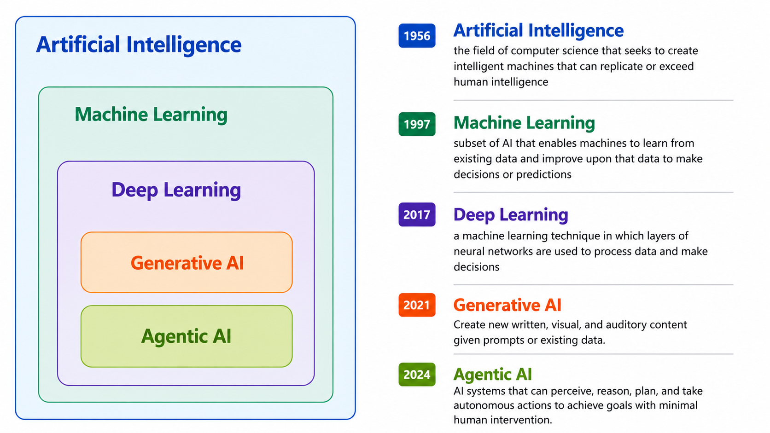
AI vs ML vs DL

Slide 8
ML / DL Model Building Flow
Model Training
Training Data
Data
Pre-processing (ETL)
Feature Selection
Testing Data
ML Model
New Data
Predictions

Slide 9
Training and Testing
Training is learning
Finds patterns
Mapping
Testing
Test machine for unknown inputs
Unknown or user inputs are used in testing

Slide 10
Types of Data Splitting
Random training testing split
Stratified training testing split
k-fold cross validation (k-fold)
Stratified k-fold Cross validation
Leave One out Cross Validation (LOOCV)
Shuffle-Split

Slide 11
Random Training and Testing split
All input data is split in two parts
A. Training
B. Testing
Example: we have 10 records
Training – 60% - random 6 records testing 40% - random 4 records
So target is machine should give good performance on testing data
Dis advantage: Model performance depends on patterns of data in training and testing
No | F1 | F2 | Y
1 |  |  | 1
2 |  |  | 1
3 |  |  | 1
4 |  |  | 1
5 |  |  | 1
6 |  |  | 0
7 |  |  | 0
8 |  |  | 0
9 |  |  | 0
10 |  |  | 0

Slide 12
Stratified Training and Testing split
Balances the target class in training and test data
Example: we have 10 records
Y== 0
Training - 60% - random 3 records testing - 40% - random 2 records
Y==1
Training - 60% - random 3 records testing - 40% - random 2 records
Dis advantage: Model performance depends on patterns of data in training and testing
No | F1 | F2 | Y
1 |  |  | 1
2 |  |  | 1
3 |  |  | 1
4 |  |  | 1
5 |  |  | 1
6 |  |  | 0
7 |  |  | 0
8 |  |  | 0
9 |  |  | 0
10 |  |  | 0

Slide 13
K fold cross validation & Stratified K-fold
In K-fold, total data is split in k parts
Means k=5 then 5 parts
Training and testing is done iteratively k number of times
In each iteration k-1 parts are training and one randomly selected part is testing
Testing will happen on all parts one by one
Final result is average of all k iterations of testing
K is given by user (5 or 10 generally)
In Stratified K-fold, in each split distribution of classes from original data is maintained like stratified random split
Itr1 | Itr2 | itr3 | Itr4 | Itr5
 |  | Test
Test
 |  |  |  | Test
 | Test
 |  |  | Test

Slide 14
Leave One Out Cross Validation (LOOCV)
Each sample is used once as a test set, while the remaining samples form the training set.
Number of iterations = No of training samples (rows)
Example: If we have dataset of 100 rows, then first iteration one random row will be test data and 99 rows in training, like this there will be 100 iterations
Limitation: Due to the high number of test sets (which is the same as the number of samples) this cross validation method can be very costly. For large datasets one should favor KFold, StratifiedKFold or ShuffleSplit.

Slide 15
Shuffle Split
It is Repeated random splitting
Data is split in training and testing ‘n’ times
There is possibility of overlap
‘n’ is given by user
Example:
If we have 20 samples and n=5, training size = 60% and test size 40%
Then there will be 10 iterations. In each iteration training data and test data will be given.

Slide 16
How a Machine Learns?
Where do you see learning taking place?
Can a machine learn on its own ?
Supervised
Un-Supervised
Reinforcement

Slide 17
Machine Learning Tasks
Prediction (Supervised)
Regression – predict a number
Ex. Predict product price based on raw material
Linear, Multivariate, Decision Tree and many other Regression methods are used.
Classification – predict a label / class
Ex. Predict Bank Loan Customer’s class either defaulter / regular
Naive Bayes, SVM, Decision Tree and many other methods are used
Forecasting (Supervised)
Predict future values – mostly numbers Ex. Share Market forecast
Can be seen as regression task
Models like ARIMA , and regression models are used

Slide 18
Machine Learning Tasks
Recommendation Systems (Supervised)
Recommend best options possible
Methods like Collaborative Filtering are used
Clustering (Un-Supervised)
Grouping Similar Items
Ex. Group movies of similar theme
Algorithms like k-means & DBSCAN clustering are used.
Outlier Detection / Fraud Detection ( Un-Supervised / Supervised)
Find the extreme values / outliers from data
Can be considered as classification / clustering task based on data
Algorithms like DBSCAN are used

Slide 19
Machine Learning Tasks
Descriptive Tasks
Subgroup Discovery (Supervised Learning)
Sub part tagging
Example
multiple object detection in one scene
Part of Speech tagging
Association Rule Discovery (Un-Supervised Learning)
Find the pattern of frequently occurring objects / things
Example
Find the rules from purchase data of a shop
Rule 1: Toothpaste and brush are purchased together
Rule 2: Honey and sugar and not bought together

Slide 20
How to Approach a ML project?
What is the question / problem being solved?
What is the target?
Which ML task to select?
Can data collected solve this?
Feature Selection
Is the data, no of samples and features, enough?
Feature selection
How to measure success of the project?
Evaluation Measures
How this project interact with other parts / users?
UI / Web Application / API

Slide 21
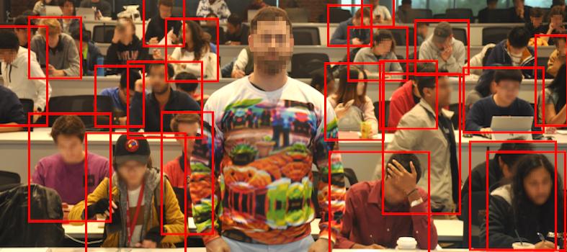
Adversarial Attacks on AI

Slide 22
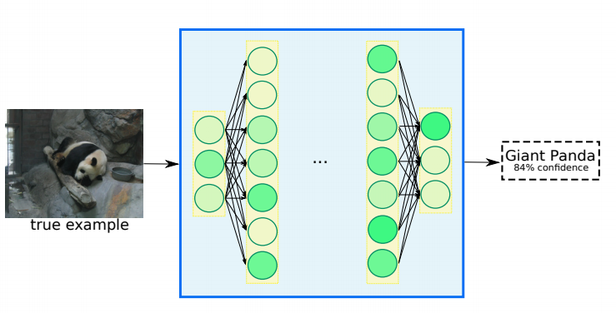
Normal working of Deep Learning / AI

Slide 23
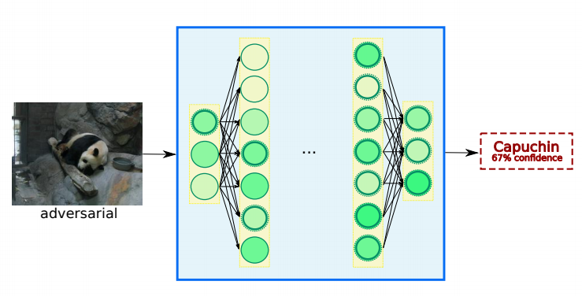
Adversarial working of Deep Learning / AI

Slide 24
AI needs Regulation!

